Slide 1

Ether.js Course
By Code Eater

Slide 2
Contents
Code Eater
Ether.js
What Is Ether.js ?
Interaction With Blockchain
Quizes
Common Terminologies
Interaction With
Smart Contract
Modules
Web3.js vs Ether.js
Code Eater

Slide 3
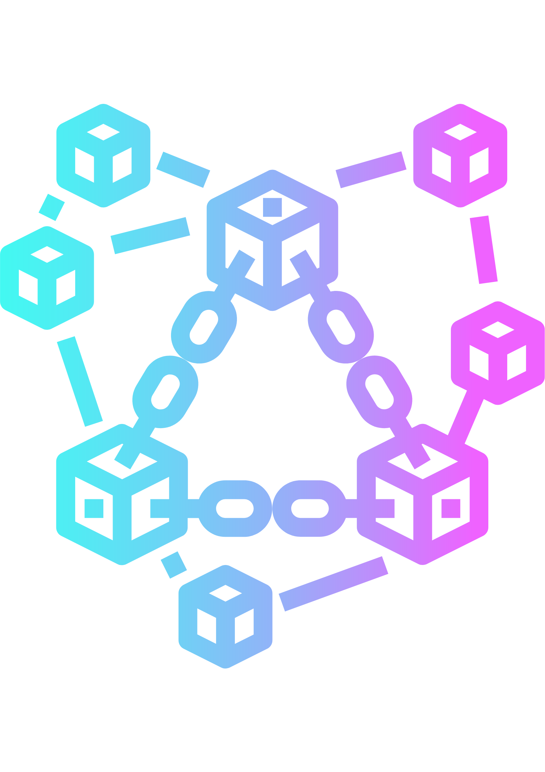

Ether.js
Code Eater
The ethers.js library aims to be a complete and compact library for interacting with the Ethereum Blockchain and its ecosystem.
Ether.js
Computer
Code Eater

Slide 4
Common Terminology
Code Eater
Provider
A Provider (in ethers) is a class which provides an abstraction for a connection to the Ethereum Network. It provides read-only access to the Blockchain and its status.
Signer
A Signer is a class which (usually) in some way directly or indirectly has access to a private key, which can sign messages and transactions to authorize the network to charge your account ether to perform operations.
Contract
A Contract is an abstraction which represents a connection to a specific contract on the Ethereum Network, so that applications can use it like a normal JavaScript object.
Code Eater

Slide 5

Installation
Code Eater
npm install --save ethers
Code Eater

Slide 6
Connecting To Blockchain
Code Eater
Code Eater

Slide 7
Ether.js
Code Eater
The ethers.js library aims to be a complete and compact library for interacting with the Ethereum Blockchain and its ecosystem.
Ether.js
Frontend
Code Eater

Slide 8

Connecting To Blockchain
Code Eater
Computer
Code Eater

Slide 9
Connecting To Blockchain
Code Eater
Q1) Alternative Of Infura ?
Ether.js
Computer
Code Eater

Slide 10

Connecting To Smart Contract
Code Eater
Code Eater

Slide 11

Two Operations
Code Eater
Read
Provider and Infura
Write
Signer and Metamask
Code Eater

Slide 12

Signer and Metamask
Code Eater
Signature
Code Eater

Slide 13
Signer and Metamask
Code Eater
Q) How our computer will interact with Smart Contract without Infura?
Signature
Code Eater

Slide 14
Connecting To Metamask
Code Eater
Code Eater

Slide 15
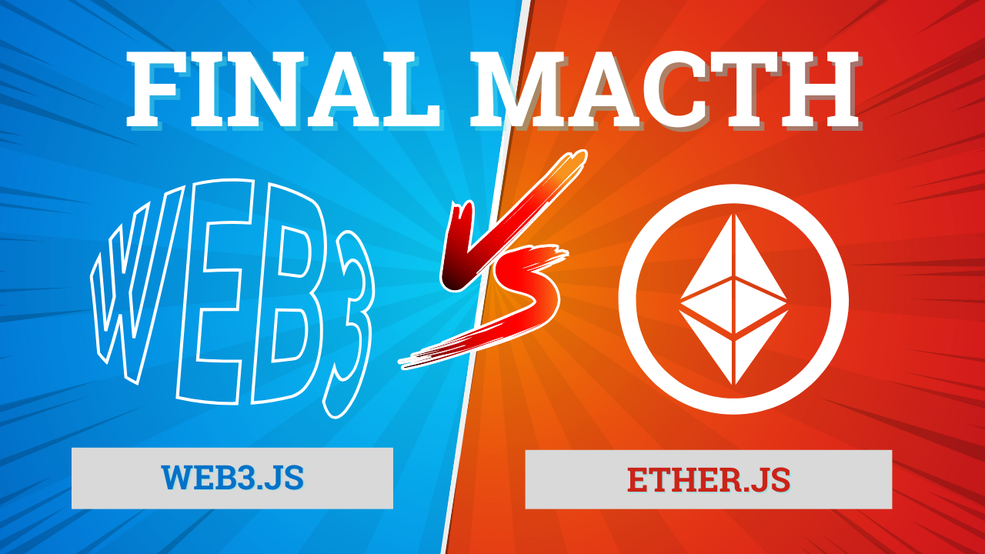

Slide 16
Advantages Of Ether.js Over Web3.js
Code Eater
Documentation
Less Bugs
New Projects
Well Maintained
Less Size
Developer Friendly
Code Eater

Slide 17

Congratulations
Code Eater
Code Eater

Slide 18
Thank You
Code Eater
Please Like and Subsribe :)
Instagram - @codeeater21
LinkedIn - @kshitijWeb3
Code Eater

Slide 19

Notes
Code Eater
Code Eater

Slide 20
Connecting to Ethereum: RPC
Code Eater
const provider = new ethers.providers.JsonRpcProvider();
If you don't specify a url, Ethers connects to the default Ganache (http://localhost:8545)
await provider.send("eth_requestAccounts", []);
MetaMask requires requesting permission to connect users accounts
const signer = provider.getSigner()
The provider also allows signing transactions to send ether and pay to change state within the blockchain. For this, we need the account signer.
Code Eater

Slide 21
Querying the Blockchain
Code Eater
await provider.getBlockNumber()
Look up the current block number
balance = await provider.getBalance("ethers.eth")
Get the balance of an account
ethers.utils.formatEther(balance)
Converts the balance in wei to ether
ethers.utils.parseEther("1.0")
If a user enters a string in an input field, you may need to convert it from ether (as a string) to wei (as a BigNumber)
Code Eater

Slide 22
Connecting to Ethereum: MetaMask
Code Eater
const provider = new ethers.providers.Web3Provider(window.ethereum)
A Web3Provider wraps a standard Web3 provider, which is what MetaMask injects as window.ethereum into each page.
await provider.send("eth_requestAccounts", []);
MetaMask requires requesting permission to connect users accounts
Code Eater

